Slide 1
Interactive Visual Analysis of Website Performance
Presentation by – Divya Shrivastava & Kirubel Tadesse
Purdue University

Slide 2


Motivation
Delay in online experience can lead to user frustration. Visualizing your website performance against other websites troubleshoot performance issues rapidly.
Compare your website against other top websites to evaluate your website performance
A statistical insight of the performance of your websites
Investigate the performance data of the critical website performance metrics in table form
Focus of previous work - more on web analytics rather than website performance

Slide 3
Design Goals
We propose an Interactive Visual Analytics tool to:
Compare your website performance against top 100 Alexa websites
Visually explore different statistical relationships between website and their performance metrics
Performance comparison on the basis of critical performance metrics affecting time
Have an interactive single dashboard having different visualization views – Histogram, Density, Bar Ranking, Table
A compact visual design having multiple views in a single dashboard for website performance analysis

Slide 4
Design Goals
For higher performance, lower value of these website performance metrics are required–
Document Complete - the point the browser loading starts and when all the static contents of the page have been loaded
Fully loaded - the point after the loading of the browser when all static, as well as dynamic elements, have been loaded.
Speed index - how rapidly the visual elements of the web page appears.
First Byte - time taken until the first byte of the base web page is received by the browser.
Start render - time between the start of the initial navigation to the web page and the first non-white content displayed on the browser.
DOM Elements - It consists of different elements of a Document in a formatted fashion

Slide 5

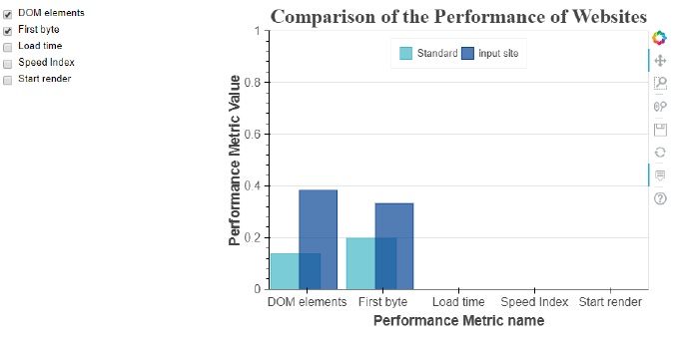
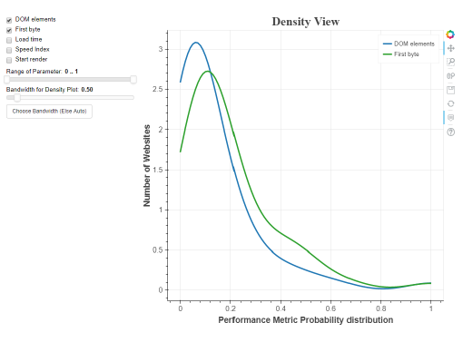
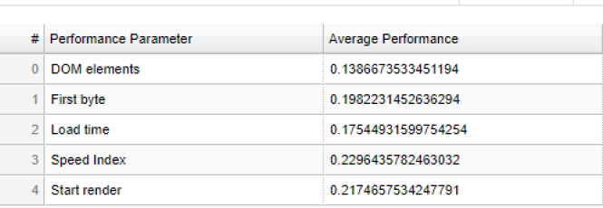
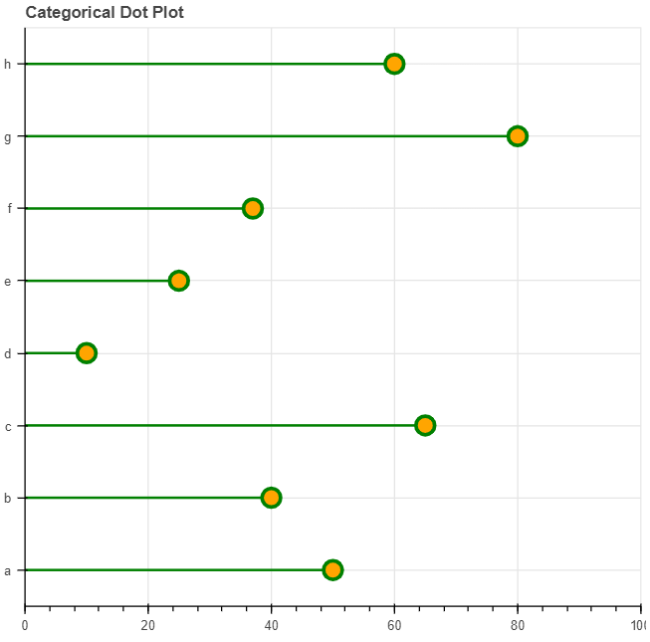
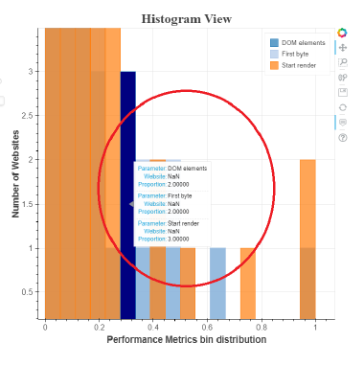
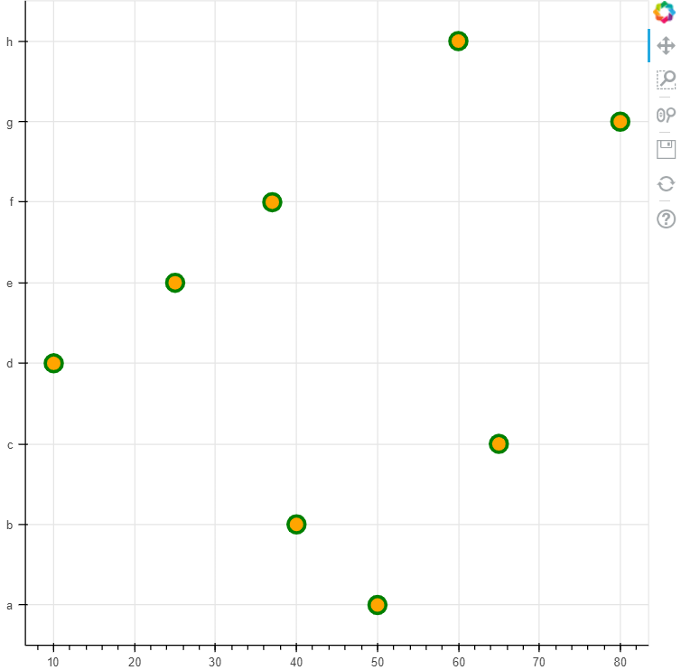
Design choices
Side by Side comparison visual
Density distribution visual
Table view
Categorical visual
Histogram distribution visual
Scatterplot
https://bokeh.pydata.org/

Slide 6
Demo

Slide 7
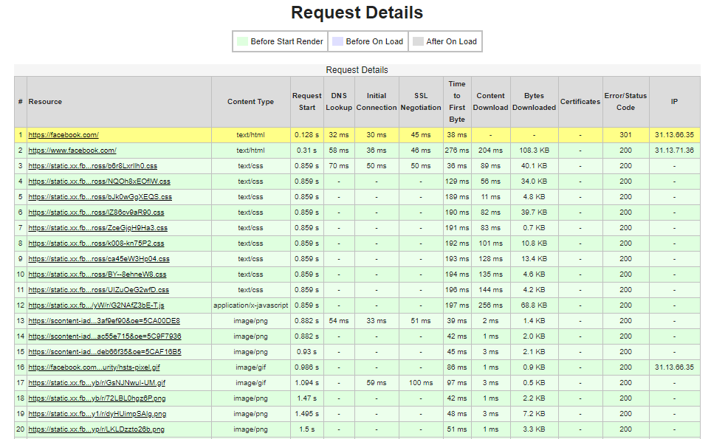
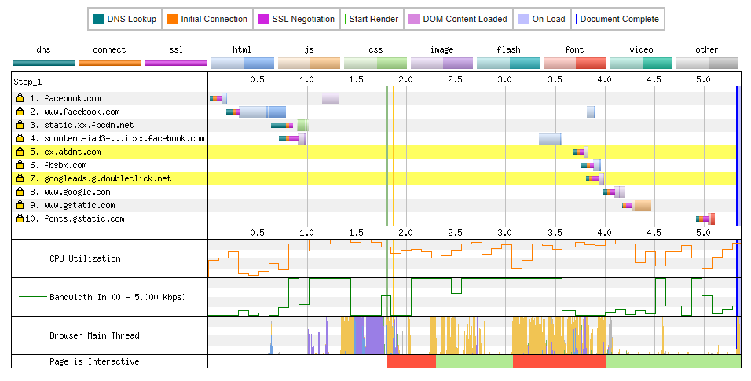
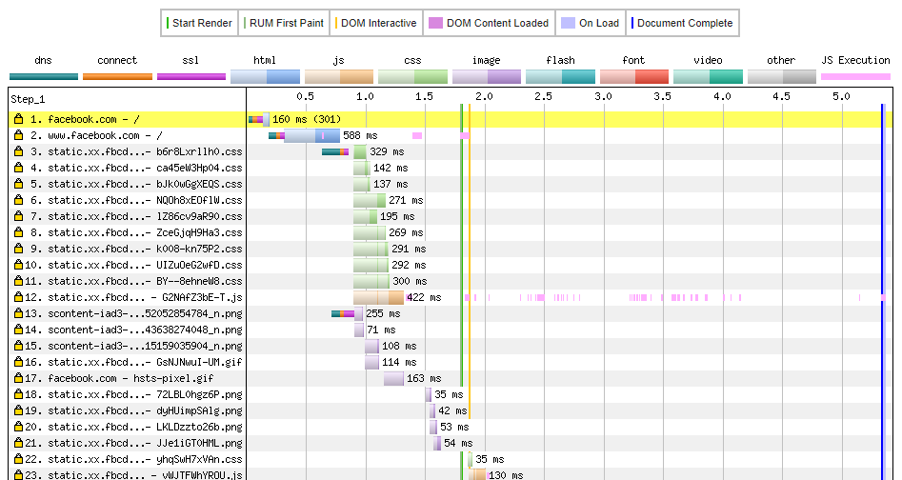
Comparison with Previous work
WebpageTest Visuals :
Request Details Connection view Waterfall view
https://www.webpagetest.org/
https://www.webpagetest.org/
https://www.webpagetest.org/

Slide 8
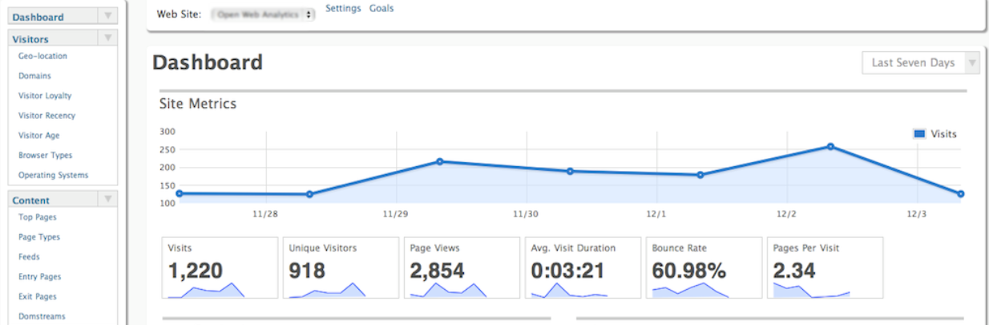
Comparison with Previous work
Existing web analytics tools for website traffic, page views, clicks, keywords that attract traffic
http://www.openwebanalytics.com/

Slide 9
Strengths/Areas of Improvements
Simple, easy to use and user interactive visual design
Comparison of the website performance with benchmark helps to understand gaps in the performance.
Statistical visual design enhances the credibility and usefulness of visual data presented
More design choices and visuals can be explored can be added in the dashboard in future
Our statistical design approach can help in predictions of website performance metrics for future extension of this work.

Slide 10
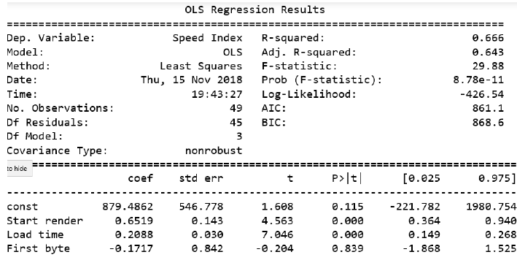
Discussion
Prediction of improvement required for website performance by prediction of the critical performance metrics
Built a Multiple regression Model using Ordinary Least Squares to find correlations between the performance metrics for website performance predictions.
This model motivates to find an appropriate relationship between the dependent and independent variables for future research for an accurate model for such predictions

